Slide 1
Project 2 - Instagram User Analytics

Slide 2
Project Description
This project is focused on analysing the given Instagram user data and to obtain important insights from it which can help in future marketing strategies. This will also provide key investors with enough information to check if user engagement in Instagram is declining or not and also to spot the fake accounts which may have certain influence on the social media platform

Slide 3
Approach
The general approach taken is that we have used SQL to get the required information from the given database. Mainly the analysis is focused on obtaining information for marketing strategies and certain user related metrics for investors.

Slide 4
Tech-Stack Used
Software used - MySQL Community Edition Workbench Version 8.0.33
This software is required because we have to retrieve the data required from a database.

Slide 5
Project SQL File Link
https://drive.google.com/file/d/1dd7LyVnqcBL8tAAzLcbDJjw6rJ_CP3oe/view?usp=sharing

Slide 6
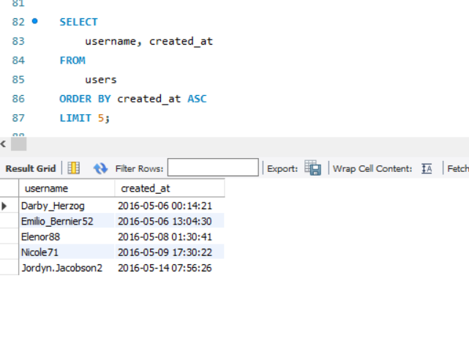
Rewarding Most Loyal Users - We are finding out the 5 oldest users here

Slide 7
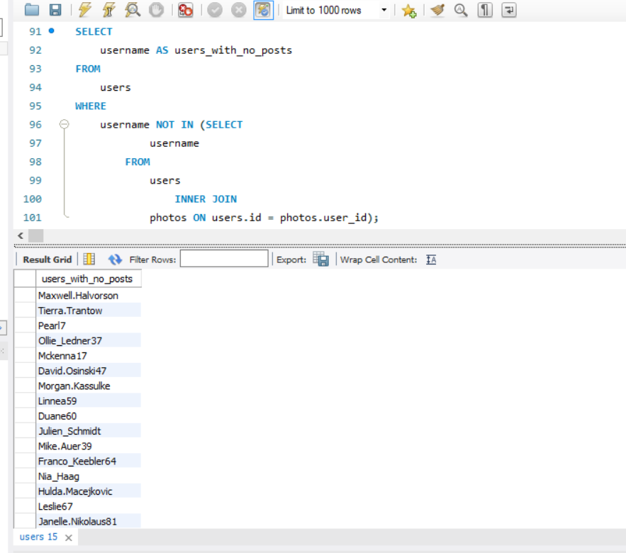
Remind Inactive Users to Start Posting - We are trying to identify those users who have never shared a post on Instagram and send them promotional emails to post their first photo.

Slide 8
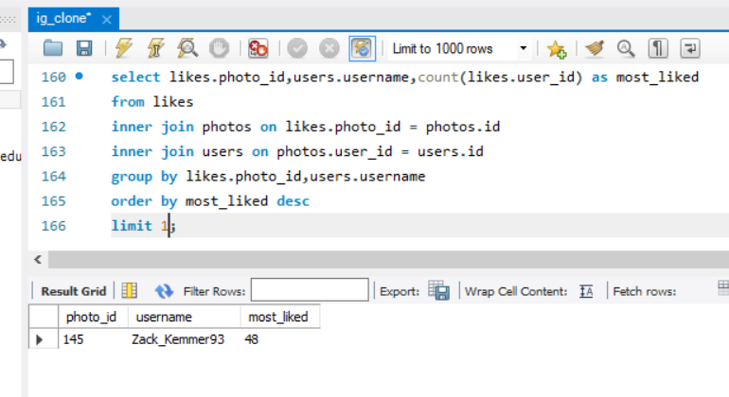
Declaring Contest Winner - Here we are trying to identify the user who has the most no of likes for a single photo and declare him/her as the winner of the contest.

Slide 9
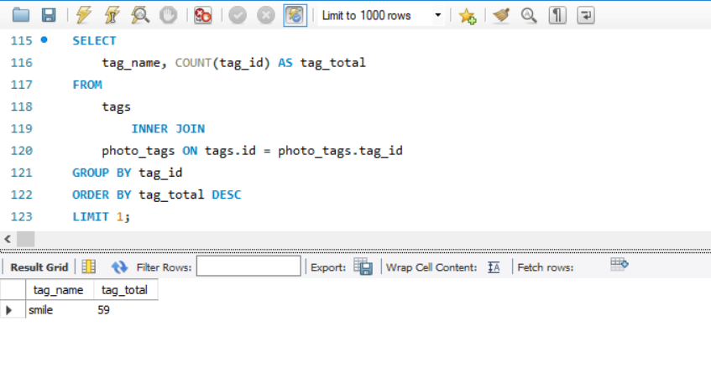
Hashtag Researching - Identifying which of the hashtag is most used by the users when they post their photo

Slide 10
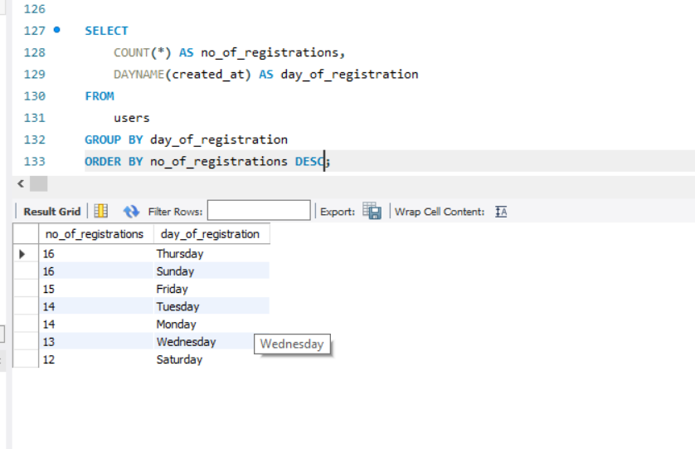
Launch AD Campaign - We identify which day of the week is the best for launching an advertisement. Here we have identified that Thursday and Sunday have the most no of registrations and thus are perfect for launchings ADs.

Slide 11
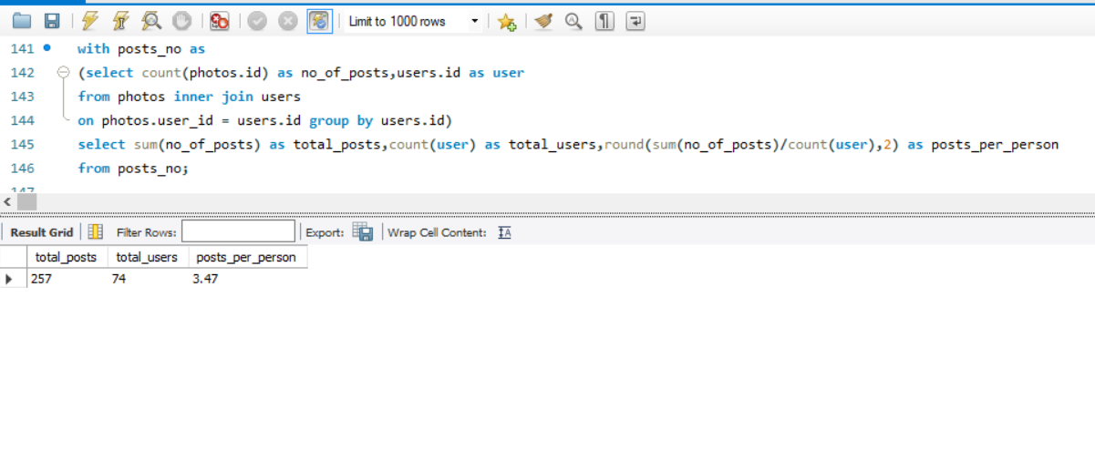
User Engagement - Here we find the average no of posts a person has made. This will help to identify if the users are still socially active on the platform or are they fading away.

Slide 12
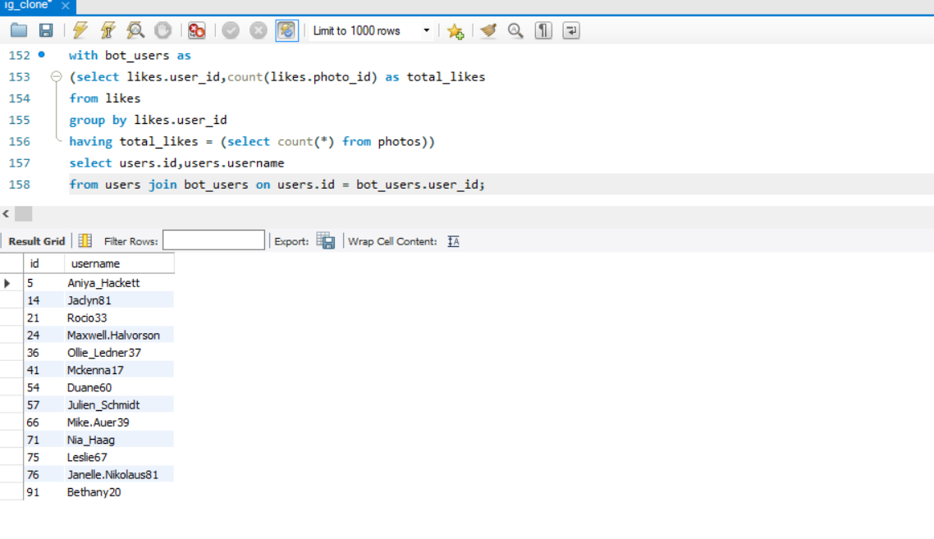
Bots & Fake Accounts - We try to identify bots/fake accounts on the platform. The criteria is that we are identifying those users who have liked every posts on Instagram. Since this is practically impossible to be done by a human, so we can conclude that the below accounts are bots.

Slide 13
Result
From the above project I have learned about the uses of SQL as a database and its practical application using Instagram platform data. I was able to write different queries for obtaining results from a complex dataset which was given and learned the use of joins, subqueries and its types, various keywords and aggregate functions etc using MySQL. Also learned about how to insert and update the table using queries in MySQL Workbench 8.0. I was able to do some basic analysis using the data given from the marketing point of view and also include some metrics for the investors to work upon.

